Slide 1

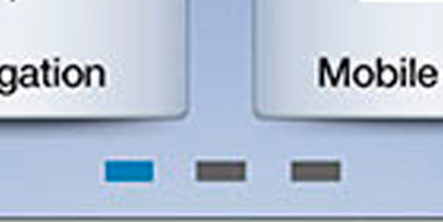

Slide 3

SMART PARK
Find New
Apps

